Slide 1
Microsoft Teams User Group Berlin
11. August 2022
Meetup #20

Slide 2
Danke!

Slide 3
Agenda
18:00 - 18:15 | Landing Zone
18:15 - 19:15 | Talk 1 – Teams Shared Channel am praktischen Beispiel Thomas Stensitzki (@stensitzki) / Christian Olschewski
19:15 - 19:45 | Microsoft Teams Neuigkeiten Thomas Stensitzki (@stensitzki)
19:45 - ? | Fragen und Antworten rund um Microsoft Teams Organisatorisches
Dieses Meeting wird aufgezeichnet und online auf YoutTube bereitgestellt. This meeting will be recorded and made available online.

Slide 4
Teams Shared Channel am praktischen Beispiel
Thomas Stensitzki (@stensitzki) Christian Olschewski

Slide 5
Teams Connect
Chat
Direkter Chat mit externen Personen außerhalb der eigenen Organisation
Shared Channels
Direkte Zusammenarbeit mit externen Personen außerhalb der eigenen Organisation
Zugriffssteuerung erfolgt in beiden Organisationen (teilend / mitarbeitend)
Zugriff für alle Anwender oder ausgewählte Anwender einer Organisation

Slide 6
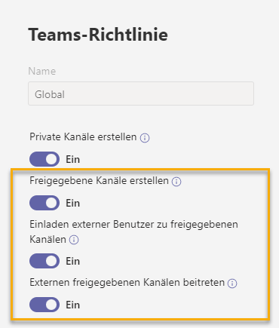
Aktivierung von Shared Channels
Teams Admin Center
Teams → Teams Richtlinien

Slide 7
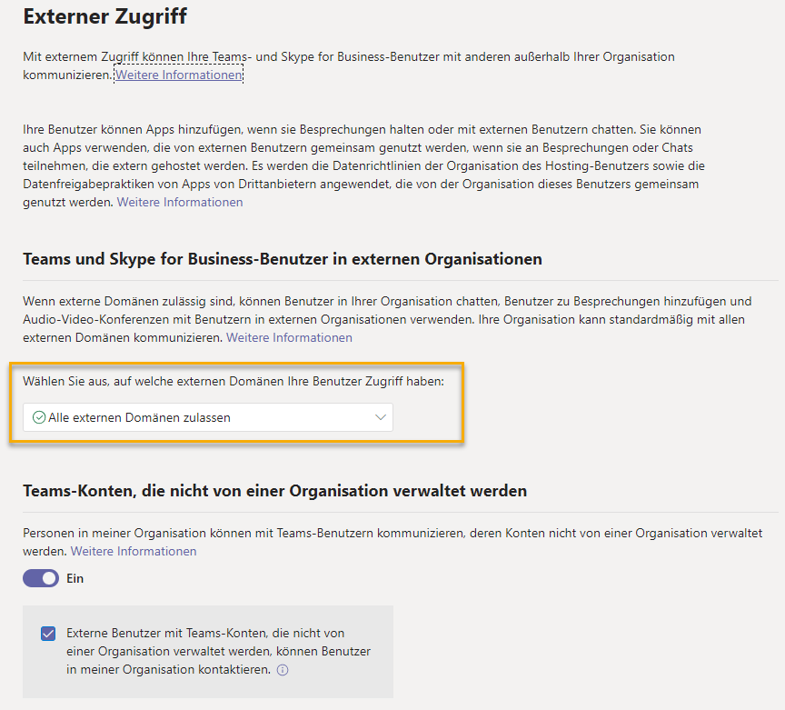
Aktivierung von Shared Channels
Teams Admin Center
Teams → Teams Richtlinien
Benutzer → Externer Zugriff

Slide 8
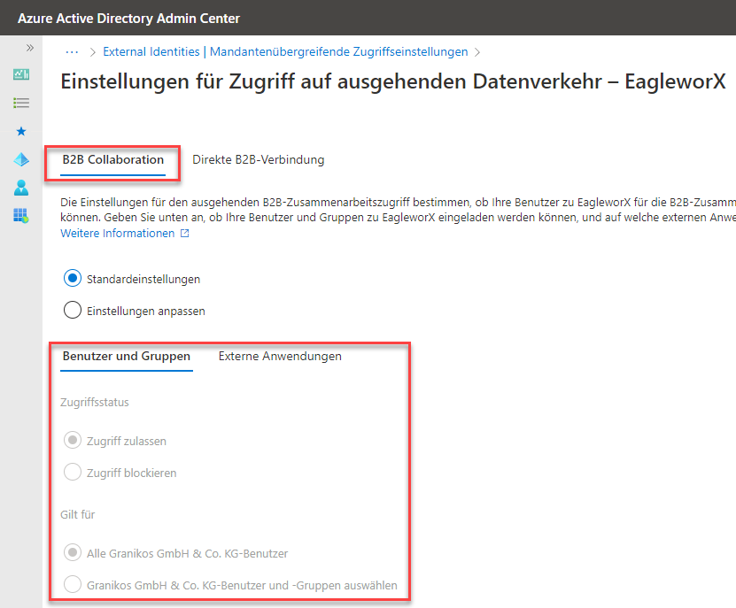
Aktivierung von Shared Channels
Teams Admin Center
Teams → Teams Richtlinien
Benutzer → Externer Zugriff
Azure AD Admin Center
Aktivierung von Azure AD B2B Direct Connect

Slide 9
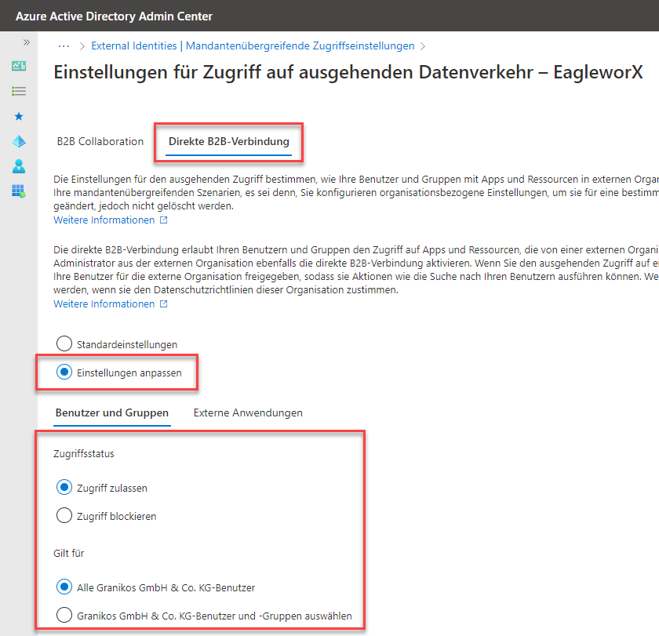
Aktivierung von Shared Channels
Teams Admin Center
Teams → Teams Richtlinien
Benutzer → Externer Zugriff
Azure AD Admin Center
Aktivierung von Azure AD B2B Direct Connect

Slide 10
DEMO

Slide 11
Ressourcen
Microsoft Teams Connect shared channels is moving into generally availability
Microsoft Teams users can now chat with any Teams user outside their organization
Shared channels in Microsoft Teams
Supported apps in shared channels
Manage external meetings and chat in Microsoft Teams
Cross-tenant access activity workbook

Slide 13
Neues in Microsoft Teams Ankündigungen & Rollouts
Updates
Meetup #20 Thomas Stensitzki

Slide 14
Neuigkeiten in Microsoft Teams
Collaborative Annotations on Presenter Shared Screen Weitere Informationen
Suggested Replies in Teams Desktop Weitere Informationen
Live Captions in all available languages and CART Captions on Teams Meetings on Web
Start a Teams Chat with Distribution Groups, Mail-Enabled Security Groups, and O365 Groups
Viva Engage, replacing Yammer Communities app for Teams Weitere Informationen

Slide 15

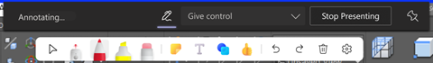
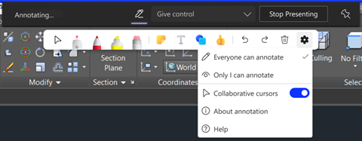
Collaborative Annotations on Presenter Shared Screen

Slide 16
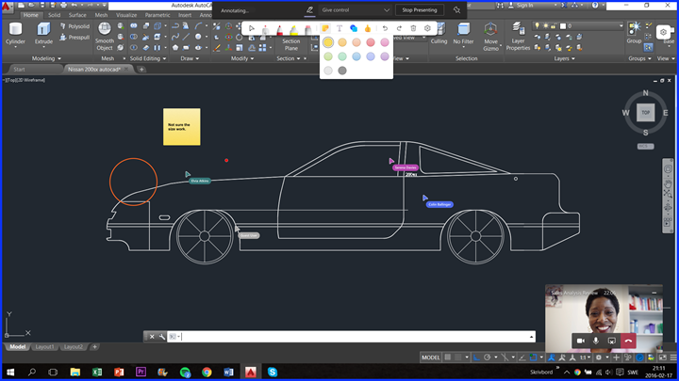
Collaborative Annotations on Presenter Shared Screen

Slide 17
Neuigkeiten in Microsoft Teams
Collaborative Annotations on Presenter Shared Screen Weitere Informationen
Suggested Replies in Teams Desktop Weitere Informationen
Live Captions in all available languages and CART Captions on Teams Meetings on Web
Start a Teams Chat with Distribution Groups, Mail-Enabled Security Groups, and O365 Groups
Viva Engage, replacing Yammer Communities app for Teams Weitere Informationen

Slide 18
Neuigkeiten in Microsoft Teams
Collaborative Annotations on Presenter Shared Screen Weitere Informationen
Suggested Replies in Teams Desktop Weitere Informationen
Live Captions in all available languages and CART Captions on Teams Meetings on Web
Start a Teams Chat with Distribution Groups, Mail-Enabled Security Groups, and O365 Groups
Viva Engage, replacing Yammer Communities app for Teams Weitere Informationen

Slide 19
Neuigkeiten in Microsoft Teams
Collaborative Annotations on Presenter Shared Screen Weitere Informationen
Suggested Replies in Teams Desktop Weitere Informationen
Live Captions in all available languages and CART Captions on Teams Meetings on Web
Start a Teams Chat with Distribution Groups, Mail-Enabled Security Groups, and O365 Groups
Viva Engage, replacing Yammer Communities app for Teams Weitere Informationen

Slide 20
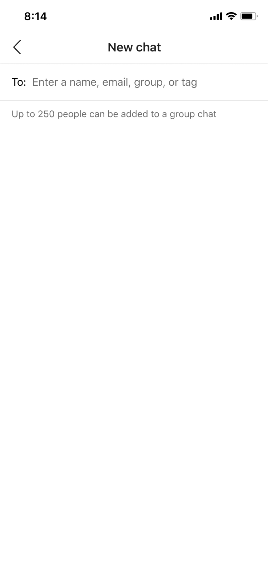
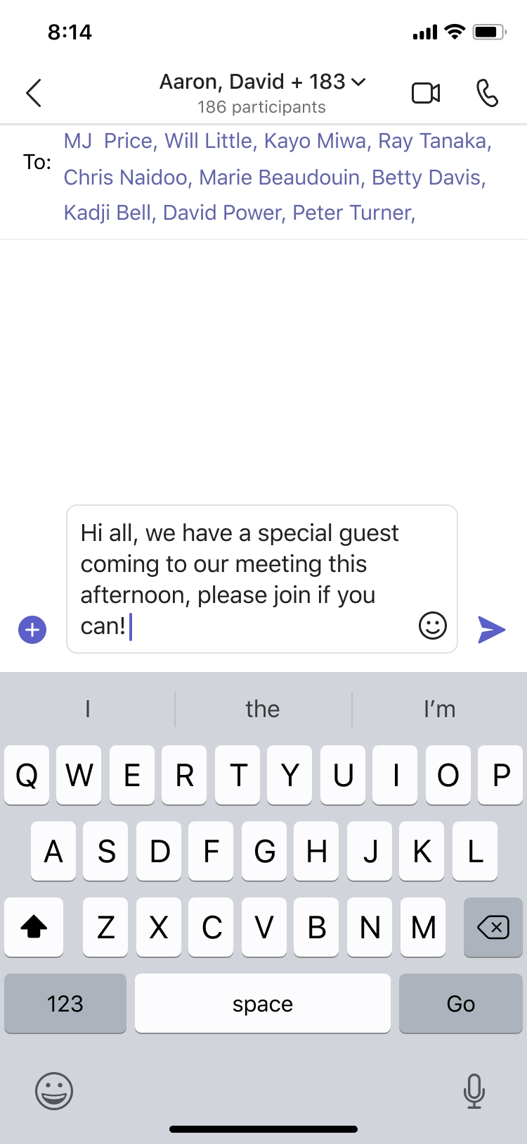
Start a Teams Chat with Distribution Groups, Mail-Enabled Security Groups, and O365 Groups
Notes:
This feature will respect the limits on members in a group chat, currently set to 250 members.

Slide 21
Neuigkeiten in Microsoft Teams
Collaborative Annotations on Presenter Shared Screen Weitere Informationen
Suggested Replies in Teams Desktop Weitere Informationen
Live Captions in all available languages and CART Captions on Teams Meetings on Web
Start a Teams Chat with Distribution Groups, Mail-Enabled Security Groups, and O365 Groups
Viva Engage, replacing Yammer Communities app for Teams Weitere Informationen

Slide 22
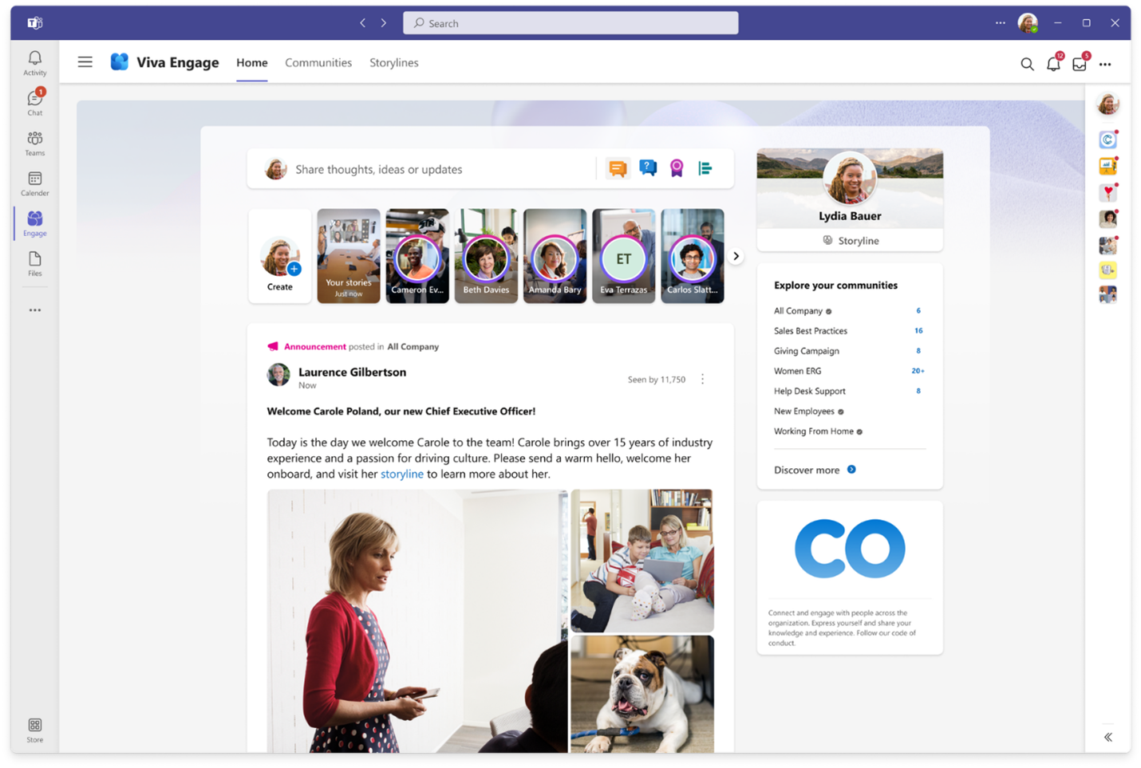
Viva Engage, replacing Yammer Communities app for Teams

Slide 23
Neuigkeiten in Microsoft Teams
Usability Improvements to In-Meeting Notifications
Assign Seats in Together Mode
Language Interpretation in Microsoft Teams Weitere Informationen
Cameo in PowerPoint Live Weitere Informationen
Recent Changes to Word, Excel, and PowerPoint integration in Teams
External Access Chat Invitation Flow for Managed Organizations
Show As now available in Teams Meetings Weitere Informationen
Speaker Coach in Microsoft Teams Meetings Weitere Informationen

Slide 24
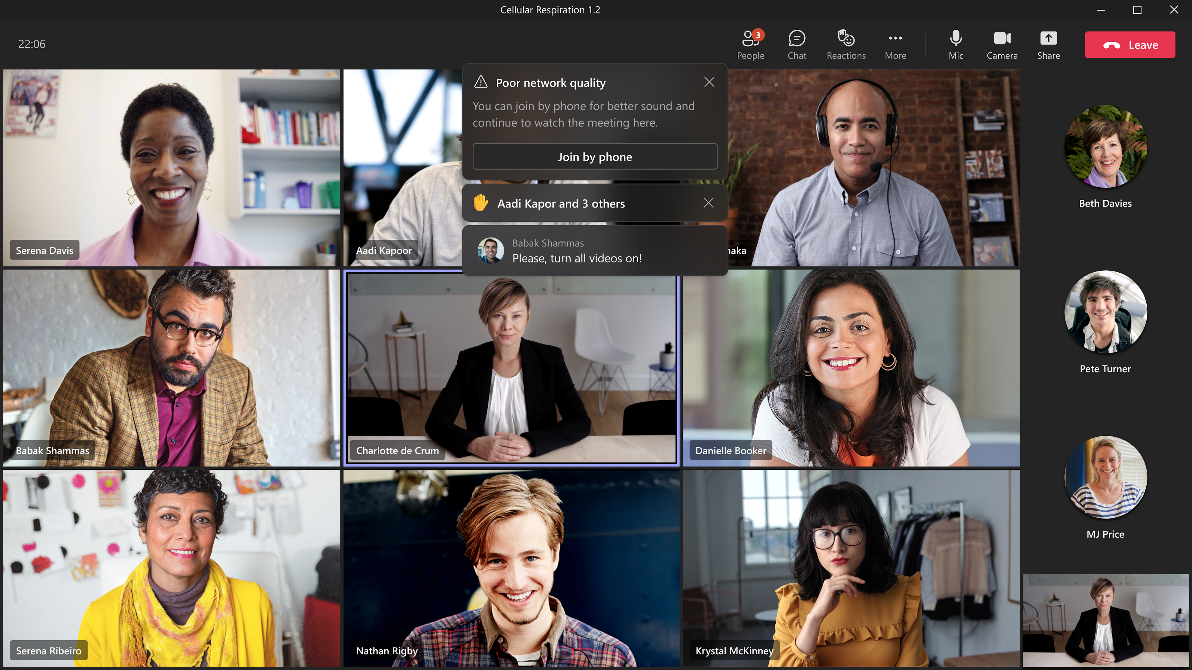
Usability Improvements to In-Meeting Notifications → September

Slide 25
Neuigkeiten in Microsoft Teams
Usability Improvements to In-Meeting Notifications
Assign Seats in Together Mode
Language Interpretation in Microsoft Teams Weitere Informationen
Cameo in PowerPoint Live Weitere Informationen
Recent Changes to Word, Excel, and PowerPoint integration in Teams
External Access Chat Invitation Flow for Managed Organizations
Show As now available in Teams Meetings Weitere Informationen
Speaker Coach in Microsoft Teams Meetings Weitere Informationen

Slide 26
Neuigkeiten in Microsoft Teams
Usability Improvements to In-Meeting Notifications
Assign Seats in Together Mode
Language Interpretation in Microsoft Teams Weitere Informationen
Cameo in PowerPoint Live Weitere Informationen
Recent Changes to Word, Excel, and PowerPoint integration in Teams
External Access Chat Invitation Flow for Managed Organizations
Show As now available in Teams Meetings Weitere Informationen
Speaker Coach in Microsoft Teams Meetings Weitere Informationen

Slide 27
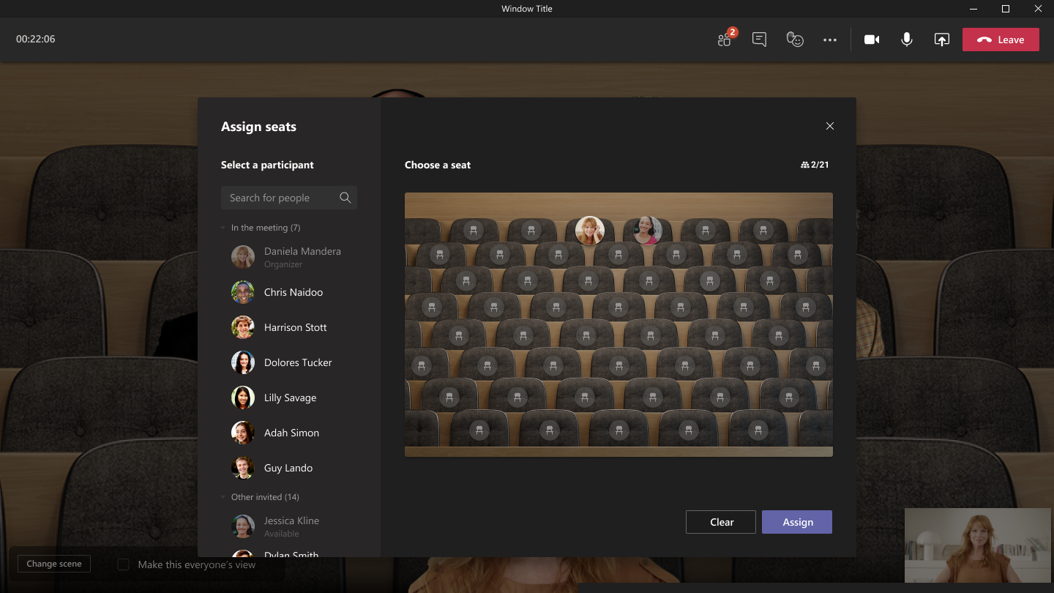
Assign Seats in Together Mode

Slide 28
Neuigkeiten in Microsoft Teams
Usability Improvements to In-Meeting Notifications
Assign Seats in Together Mode
Language Interpretation in Microsoft Teams Weitere Informationen
Cameo in PowerPoint Live Weitere Informationen
Recent Changes to Word, Excel, and PowerPoint integration in Teams
External Access Chat Invitation Flow for Managed Organizations
Show As now available in Teams Meetings Weitere Informationen
Speaker Coach in Microsoft Teams Meetings Weitere Informationen

Slide 29
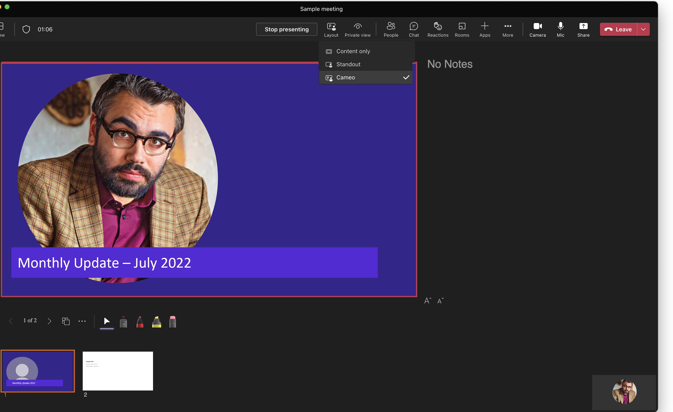
Cameo in PowerPoint Live

Slide 30
Neuigkeiten in Microsoft Teams
Usability Improvements to In-Meeting Notifications
Assign Seats in Together Mode
Language Interpretation in Microsoft Teams Weitere Informationen
Cameo in PowerPoint Live Weitere Informationen
Recent Changes to Word, Excel, and PowerPoint integration in Teams
External Access Chat Invitation Flow for Managed Organizations
Show As now available in Teams Meetings Weitere Informationen
Speaker Coach in Microsoft Teams Meetings Weitere Informationen

Slide 31
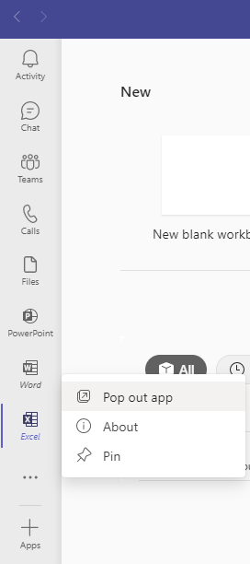
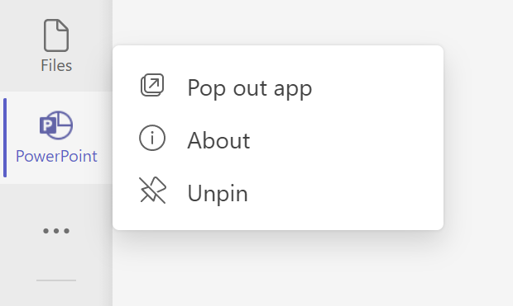
Recent Changes to Word, Excel, and PowerPoint integration in Teams
Notes:
Teams Personal Apps

Slide 32
Neuigkeiten in Microsoft Teams
Usability Improvements to In-Meeting Notifications
Assign Seats in Together Mode
Language Interpretation in Microsoft Teams Weitere Informationen
Cameo in PowerPoint Live Weitere Informationen
Recent Changes to Word, Excel, and PowerPoint integration in Teams
External Access Chat Invitation Flow for Managed Organizations
Show As now available in Teams Meetings Weitere Informationen
Speaker Coach in Microsoft Teams Meetings Weitere Informationen

Slide 33
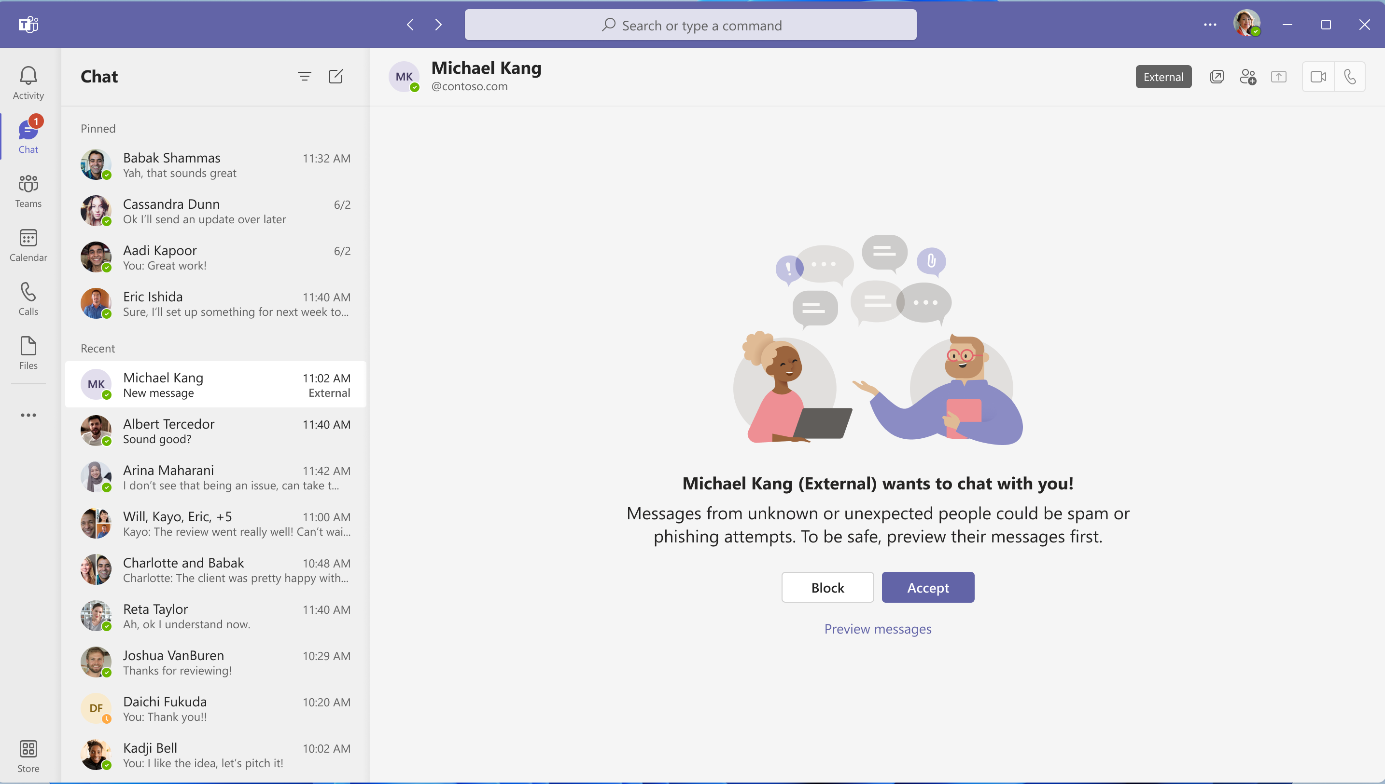
External Access Chat Invitation Flow for Managed Organizations

Slide 34
Neuigkeiten in Microsoft Teams
Usability Improvements to In-Meeting Notifications
Assign Seats in Together Mode
Language Interpretation in Microsoft Teams Weitere Informationen
Cameo in PowerPoint Live Weitere Informationen
Recent Changes to Word, Excel, and PowerPoint integration in Teams
External Access Chat Invitation Flow for Managed Organizations
Show As now available in Teams Meetings Weitere Informationen
Speaker Coach in Microsoft Teams Meetings Weitere Informationen

Slide 35
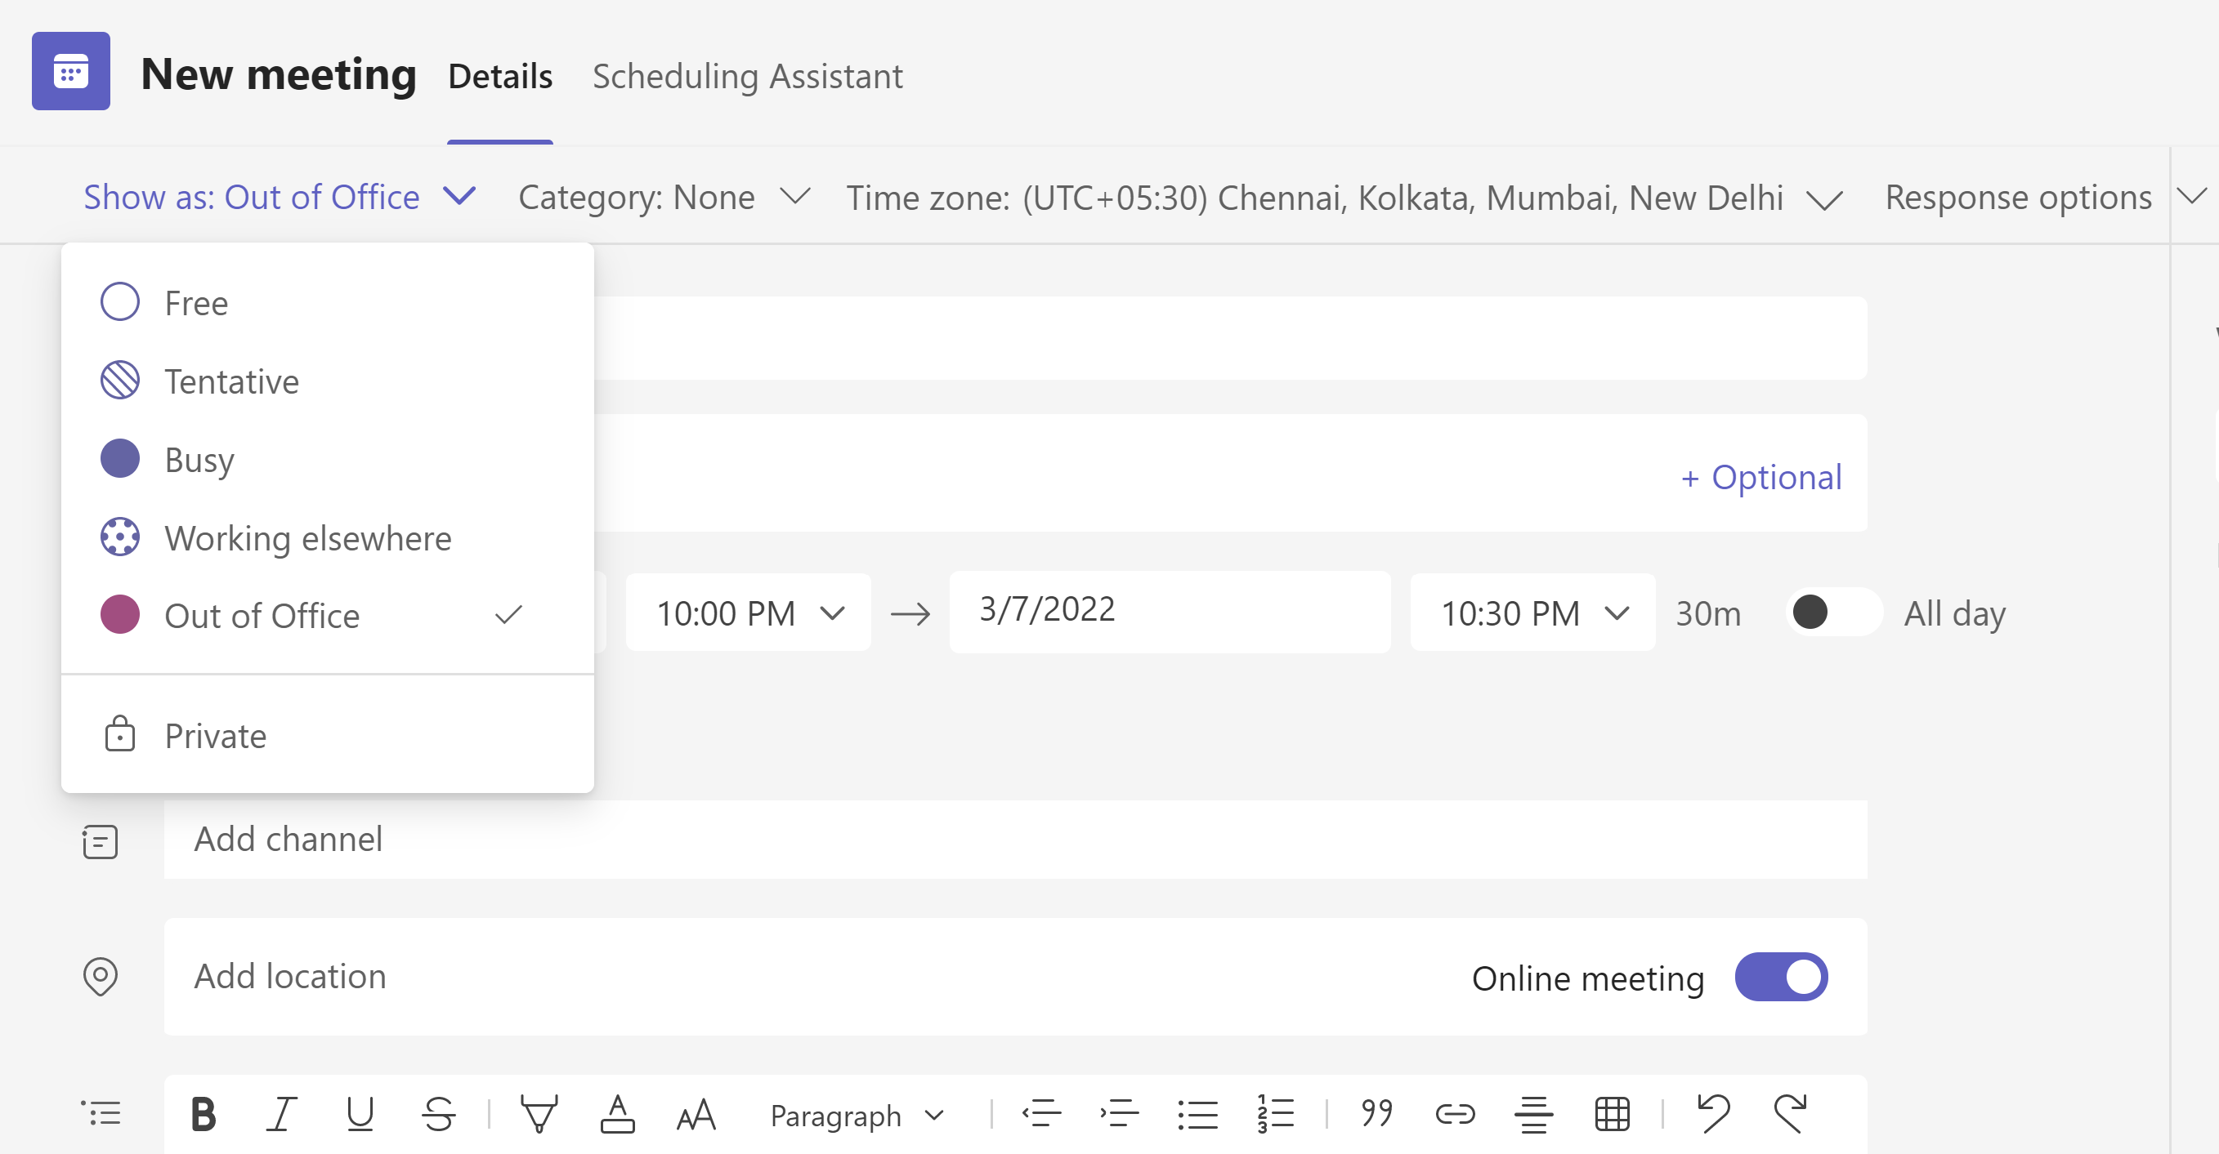
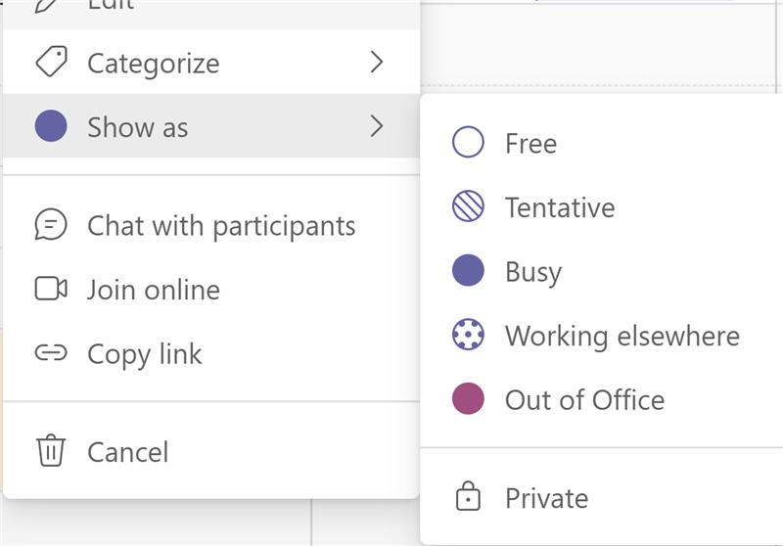
Show As now available in Teams Meetings

Slide 36
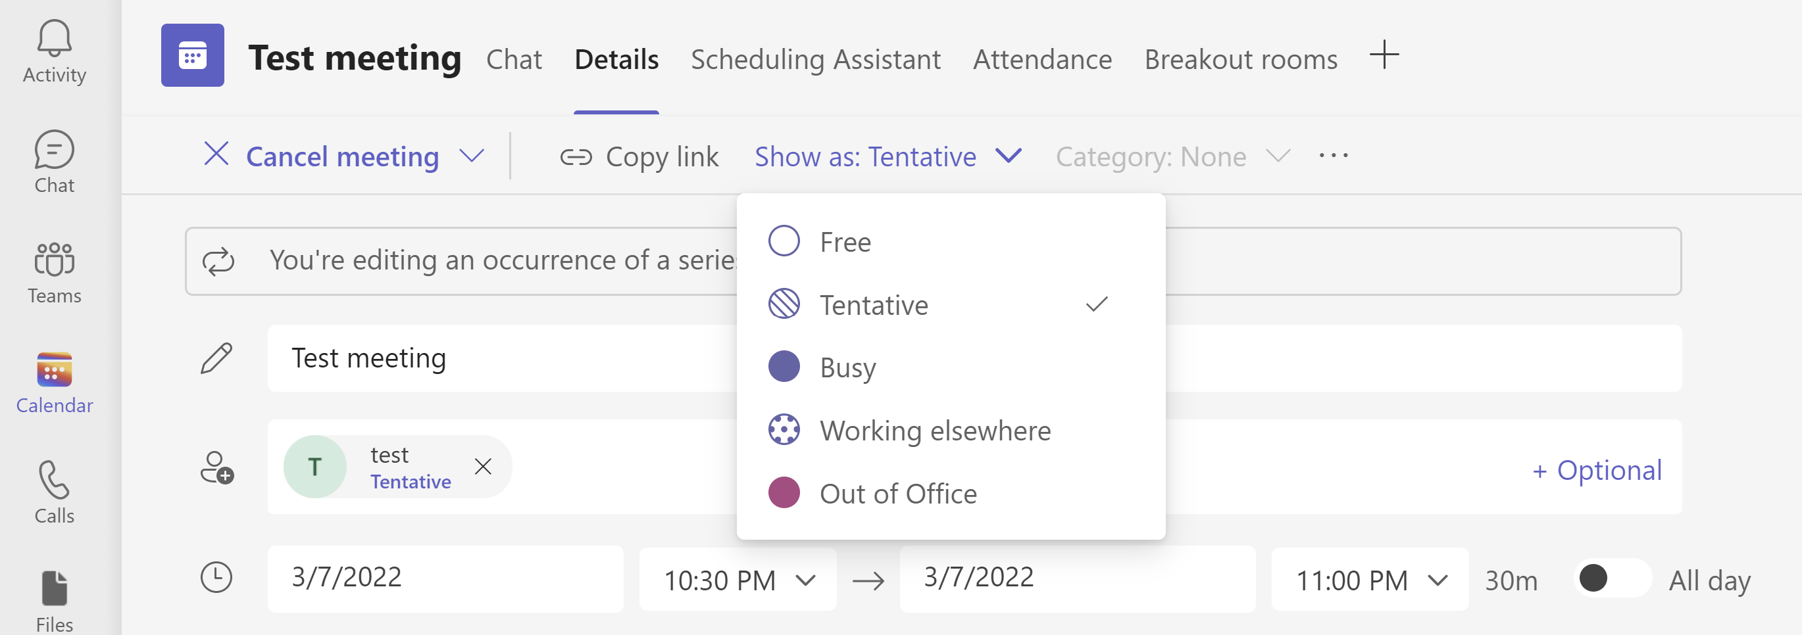
Show As now available in Teams Meetings

Slide 37
Neuigkeiten in Microsoft Teams
Usability Improvements to In-Meeting Notifications
Assign Seats in Together Mode
Language Interpretation in Microsoft Teams Weitere Informationen
Cameo in PowerPoint Live Weitere Informationen
Recent Changes to Word, Excel, and PowerPoint integration in Teams
External Access Chat Invitation Flow for Managed Organizations
Show As now available in Teams Meetings Weitere Informationen
Speaker Coach in Microsoft Teams Meetings Weitere Informationen

Slide 38
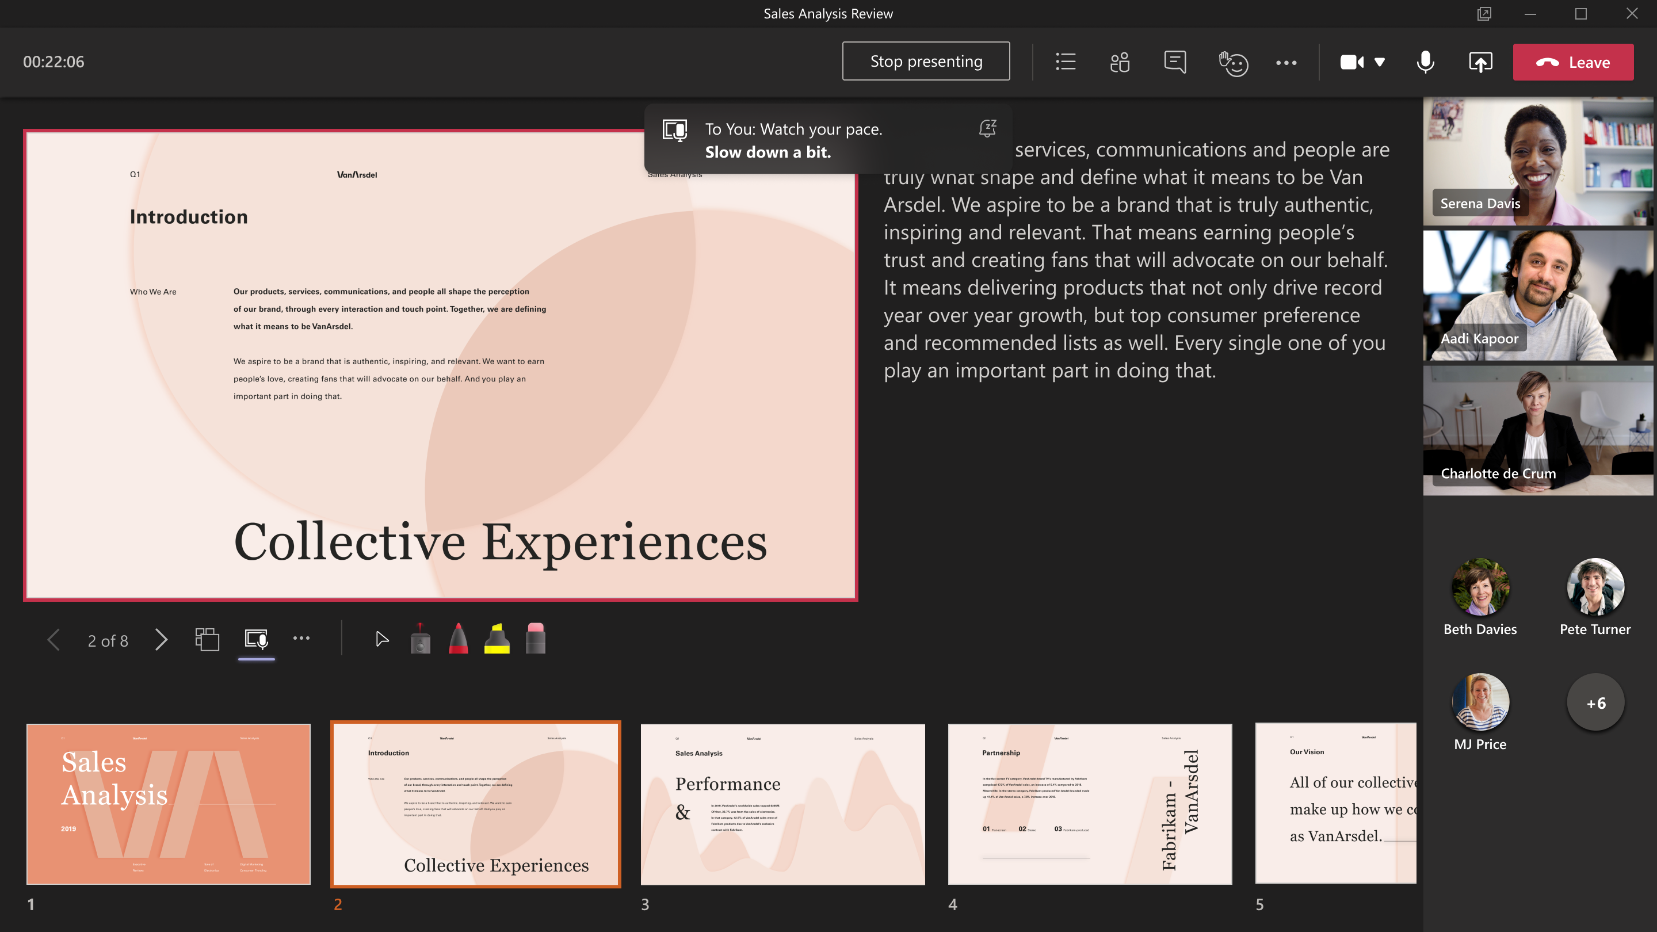
Speaker Coach in Microsoft Teams Meetings
Notes:
https://techcommunity.microsoft.com/t5/microsoft-365-blog/powerpoint-s-presenter-coach-expands-to-microsoft-teams-and/ba-p/2686087?WT.mc_id=TM-MVP-5003086

Slide 39
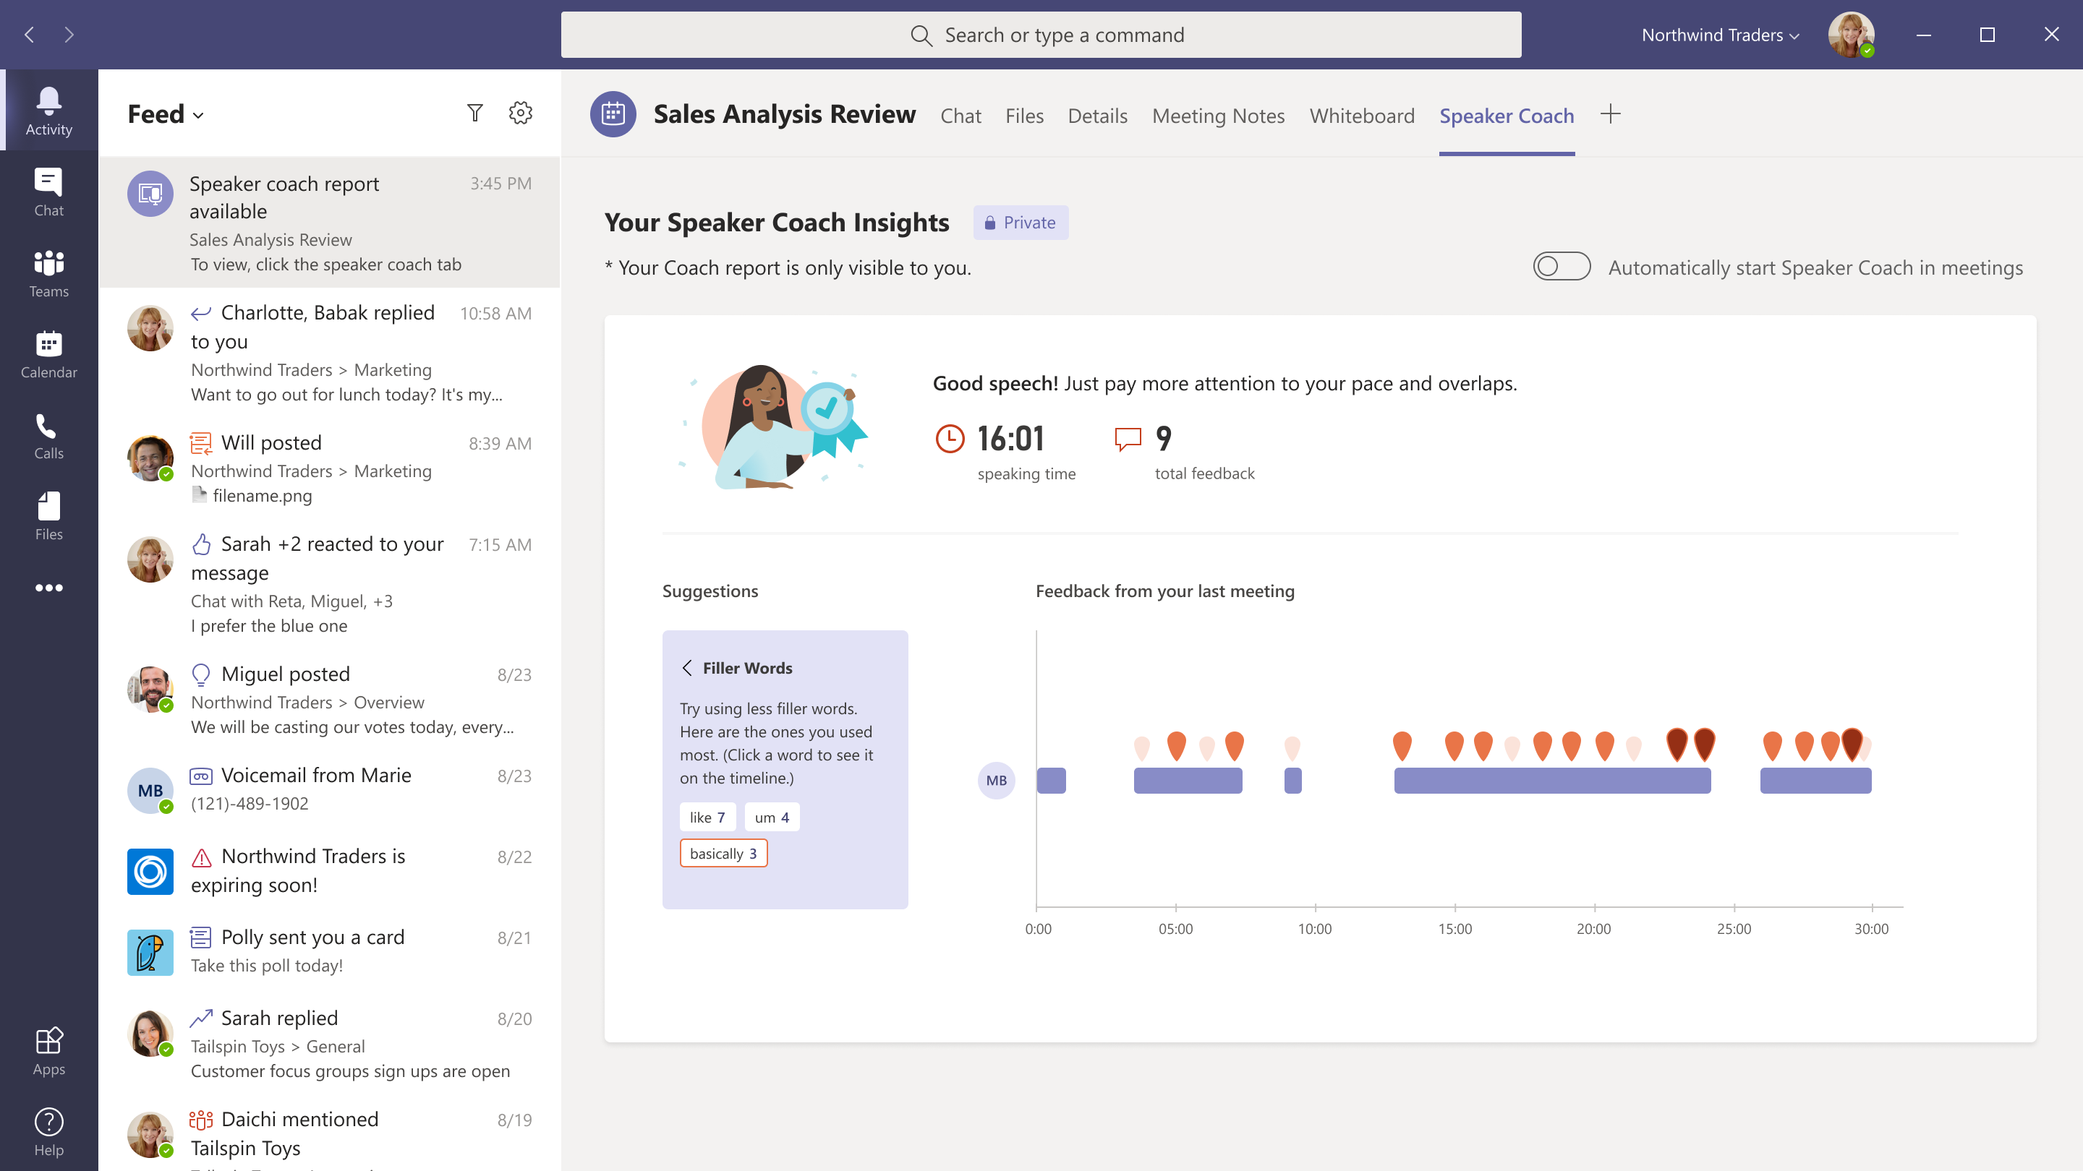
Speaker Coach in Microsoft Teams Meetings

Slide 40
Neues in Microsoft Teams Ankündigungen & Rollouts für Admins
Updates
Meetup #20 Thomas Stensitzki

Slide 41
Neuigkeiten in Microsoft Teams für Admins
Microsoft Teams user request configuration to external systems (URL redirect)
Pre-assign Channel members to Breakout Rooms
Customizable dashboard in Teams admin center
Unassign Policies in Bulk in Microsoft Teams Admin Center
Microsoft Teams Real-Time Analytics - Extended Telemetry Preview Weitere Informationen
Ability to manage third-party app subscriptions from Teams Admin Weitere Informationen

Slide 42
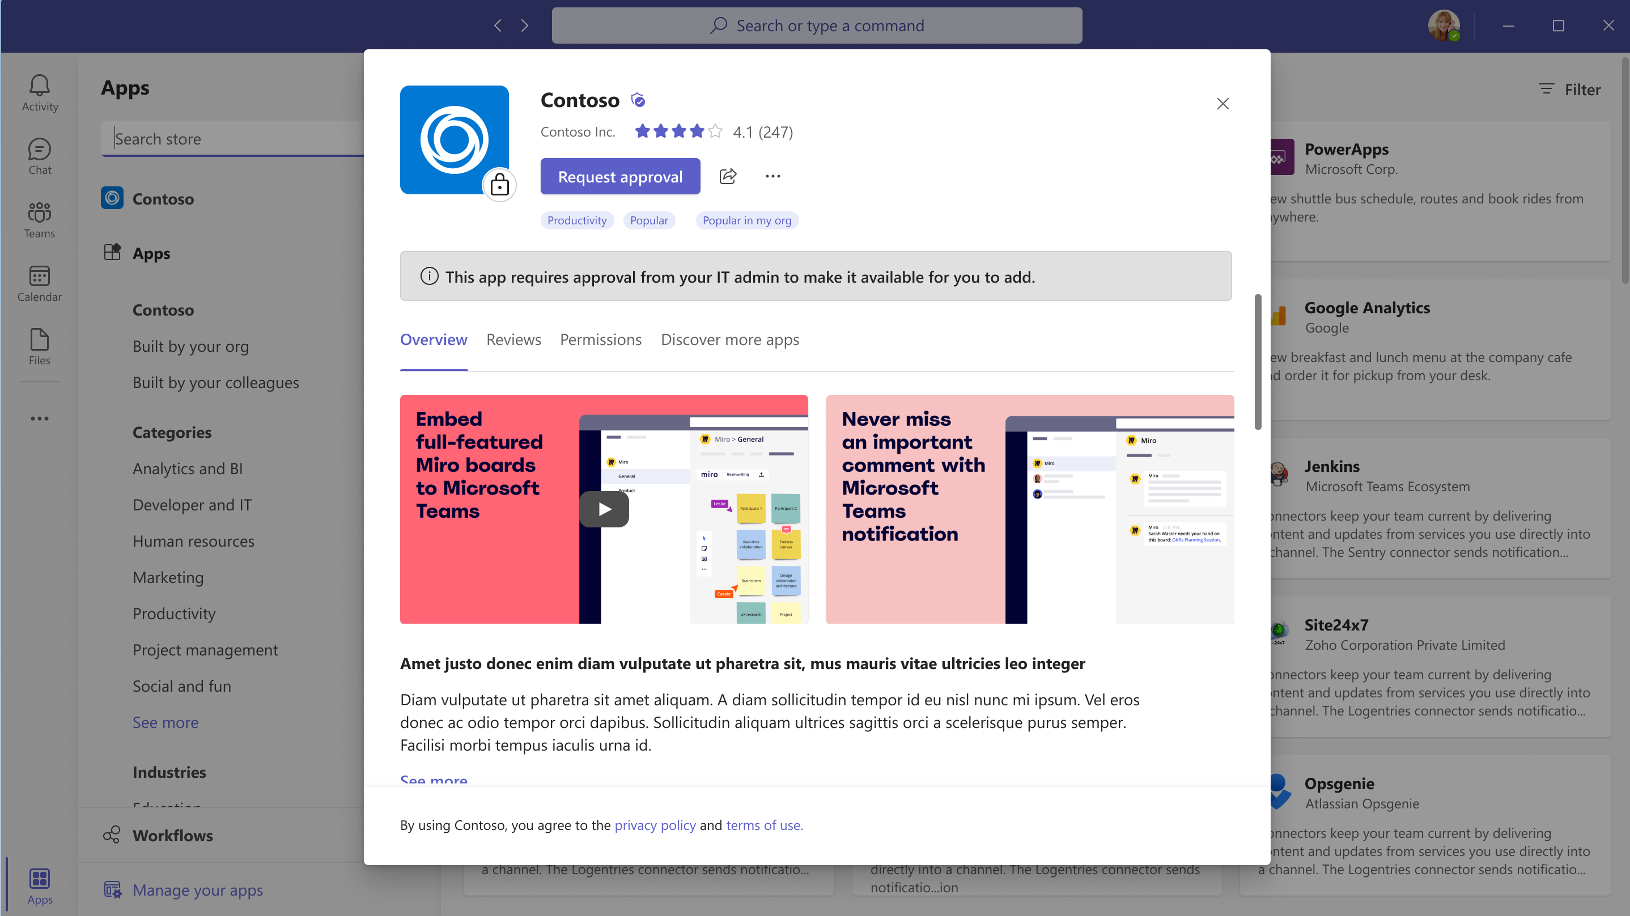
Microsoft Teams user request configuration to external systems (URL redirect)

Slide 43
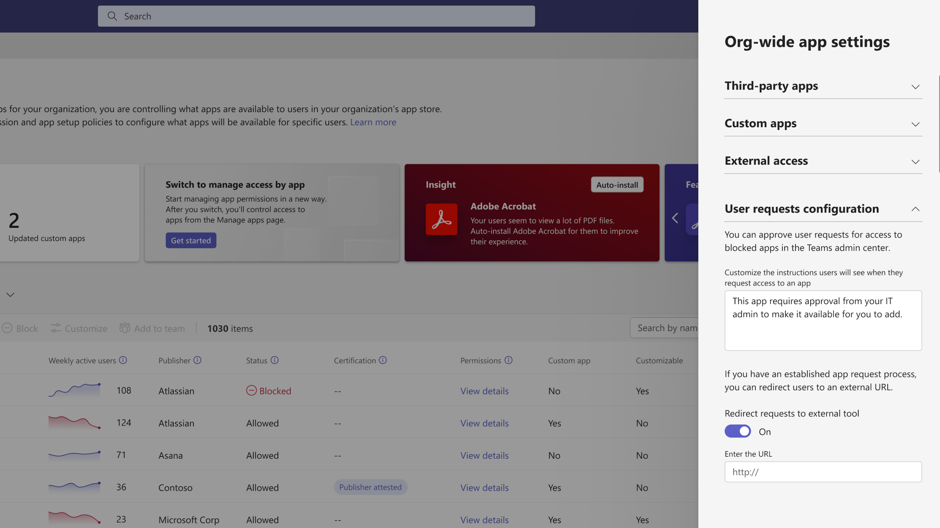
Microsoft Teams user request configuration to external systems (URL redirect)

Slide 44
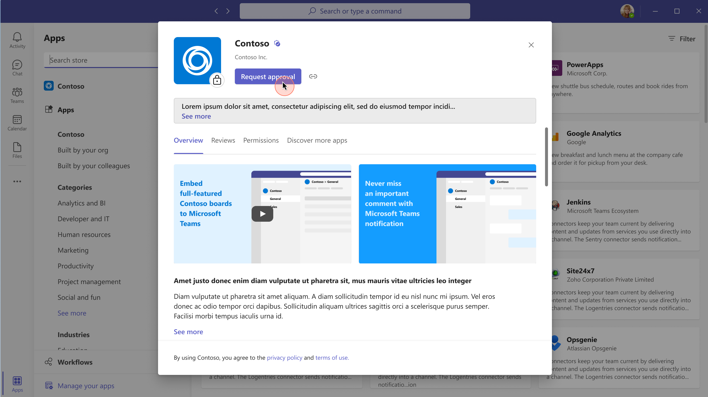
Microsoft Teams user request configuration to external systems (URL redirect)

Slide 45
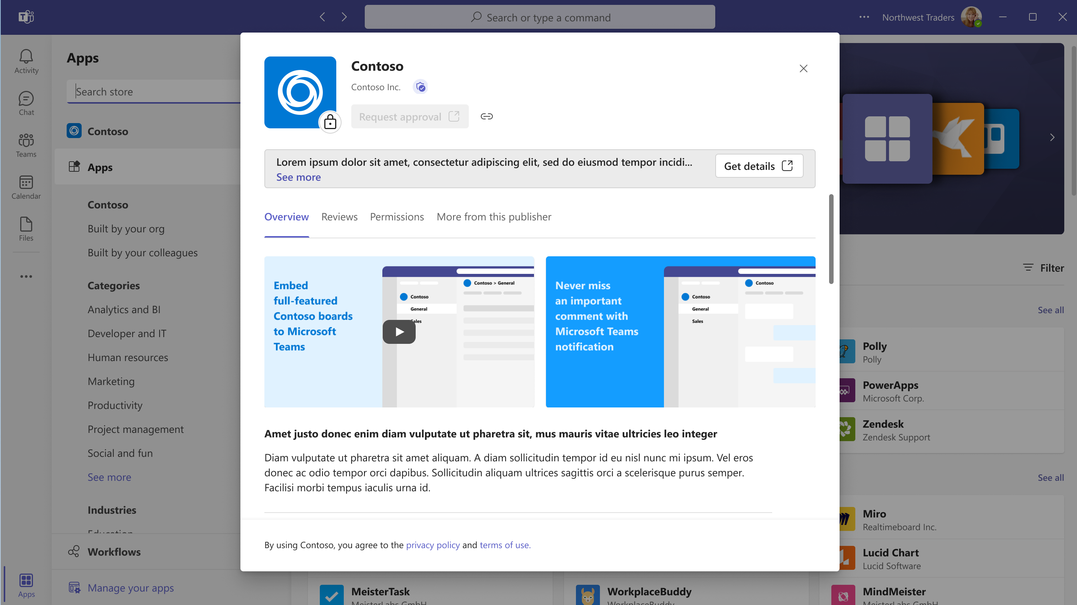
Microsoft Teams user request configuration to external systems (URL redirect)

Slide 46
Neuigkeiten in Microsoft Teams für Admins
Microsoft Teams user request configuration to external systems (URL redirect)
Pre-assign Channel members to Breakout Rooms
Customizable dashboard in Teams admin center
Unassign Policies in Bulk in Microsoft Teams Admin Center
Microsoft Teams Real-Time Analytics - Extended Telemetry Preview Weitere Informationen
Ability to manage third-party app subscriptions from Teams Admin Weitere Informationen

Slide 47
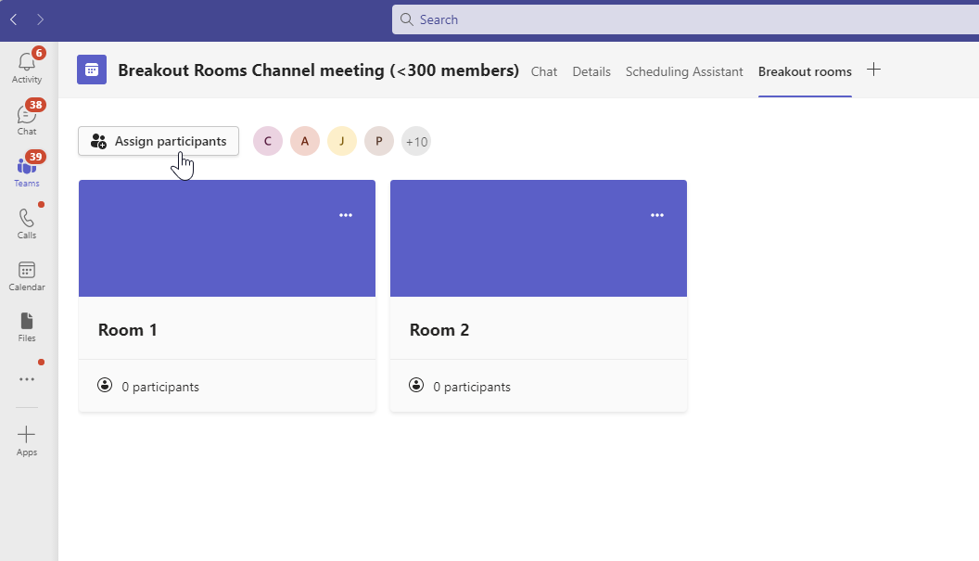
Pre-assign Channel members to Breakout Rooms
Notes:
Please note, that Meetings with Breakout Rooms are limited to 300 participants. If the channel contains more than 300 members, pre-assignment will not be available.

Slide 48
Neuigkeiten in Microsoft Teams für Admins
Microsoft Teams user request configuration to external systems (URL redirect)
Pre-assign Channel members to Breakout Rooms
Customizable dashboard in Teams admin center
Unassign Policies in Bulk in Microsoft Teams Admin Center
Microsoft Teams Real-Time Analytics - Extended Telemetry Preview Weitere Informationen
Ability to manage third-party app subscriptions from Teams Admin Weitere Informationen

Slide 49
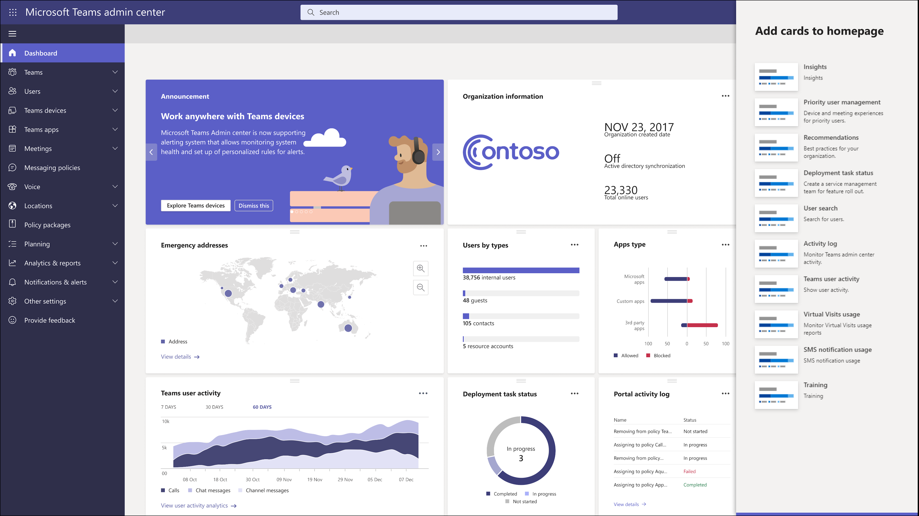
Customizable dashboard in Teams admin center

Slide 50
Neuigkeiten in Microsoft Teams für Admins
Microsoft Teams user request configuration to external systems (URL redirect)
Pre-assign Channel members to Breakout Rooms
Customizable dashboard in Teams admin center
Unassign Policies in Bulk in Microsoft Teams Admin Center
Microsoft Teams Real-Time Analytics - Extended Telemetry Preview Weitere Informationen
Ability to manage third-party app subscriptions from Teams Admin Weitere Informationen

Slide 51
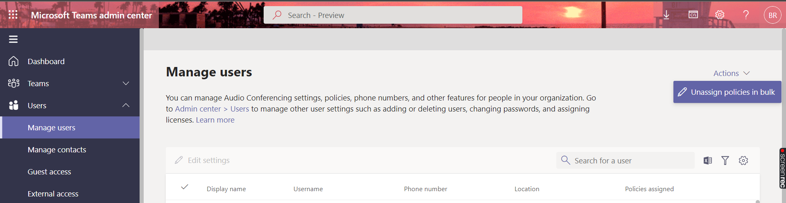
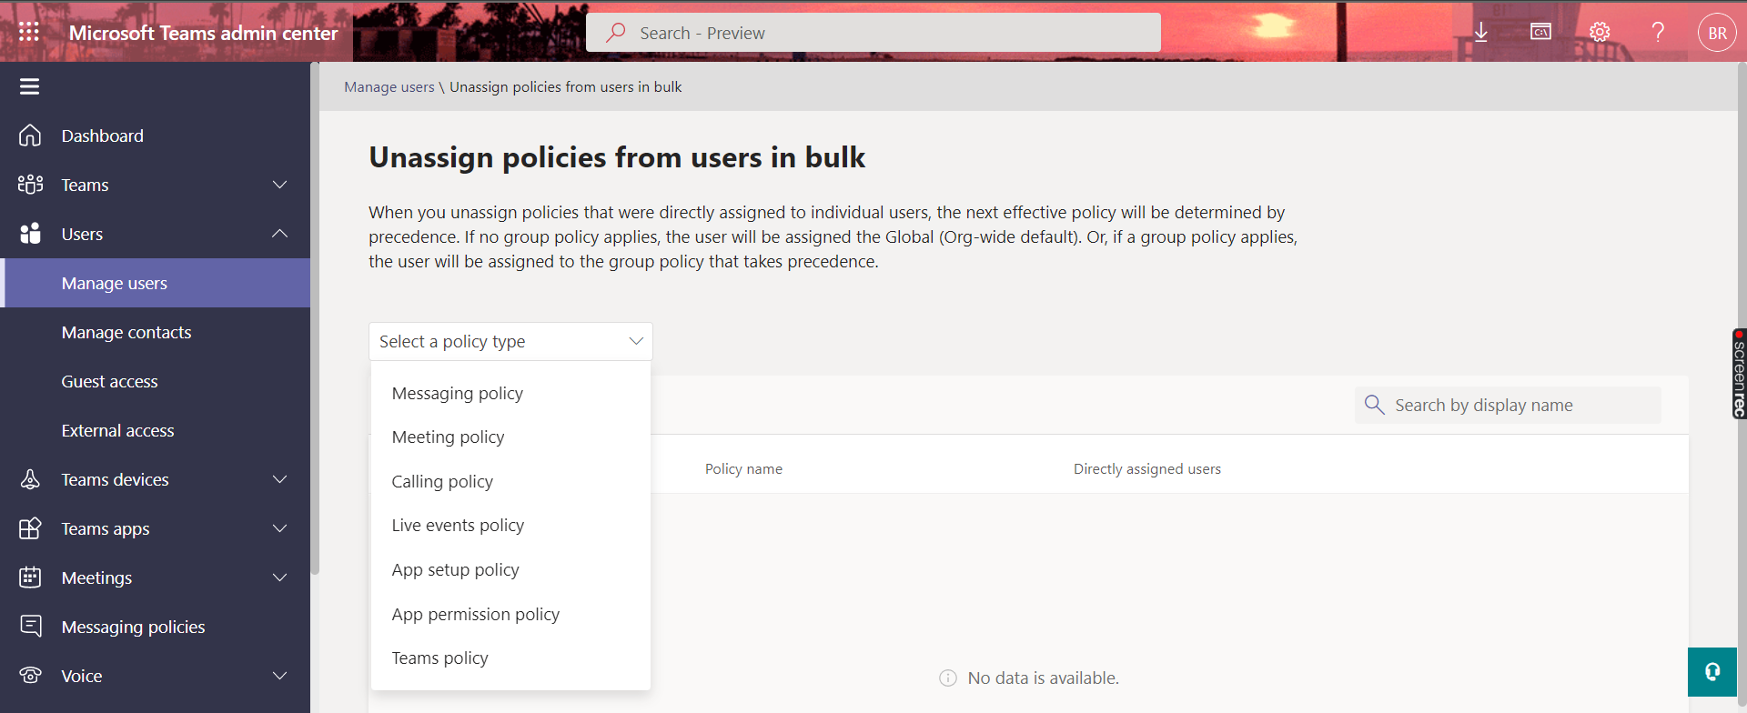
Unassign Policies in Bulk in Microsoft Teams Admin Center

Slide 52
Neuigkeiten in Microsoft Teams für Admins
Microsoft Teams user request configuration to external systems (URL redirect)
Pre-assign Channel members to Breakout Rooms
Customizable dashboard in Teams admin center
Unassign Policies in Bulk in Microsoft Teams Admin Center
Microsoft Teams Real-Time Analytics - Extended Telemetry Preview Weitere Informationen
Ability to manage third-party app subscriptions from Teams Admin Weitere Informationen

Slide 53
Microsoft Teams Real-Time Analytics - Extended Telemetry Preview
Real-Time Analytics History Default
24h
Real-Time Analytics History Default während der Preview
7 Tage
Real-Time Analytics History Default nach der Preview
24h ohne Advanced Communications Add-On Lizenz
7 Tage mit Advanced Communications Add-On Lizenz

Slide 54
Neuigkeiten in Microsoft Teams für Admins
Microsoft Teams user request configuration to external systems (URL redirect)
Pre-assign Channel members to Breakout Rooms
Customizable dashboard in Teams admin center
Unassign Policies in Bulk in Microsoft Teams Admin Center
Microsoft Teams Real-Time Analytics - Extended Telemetry Preview Weitere Informationen
Ability to manage third-party app subscriptions from Teams Admin Weitere Informationen

Slide 55
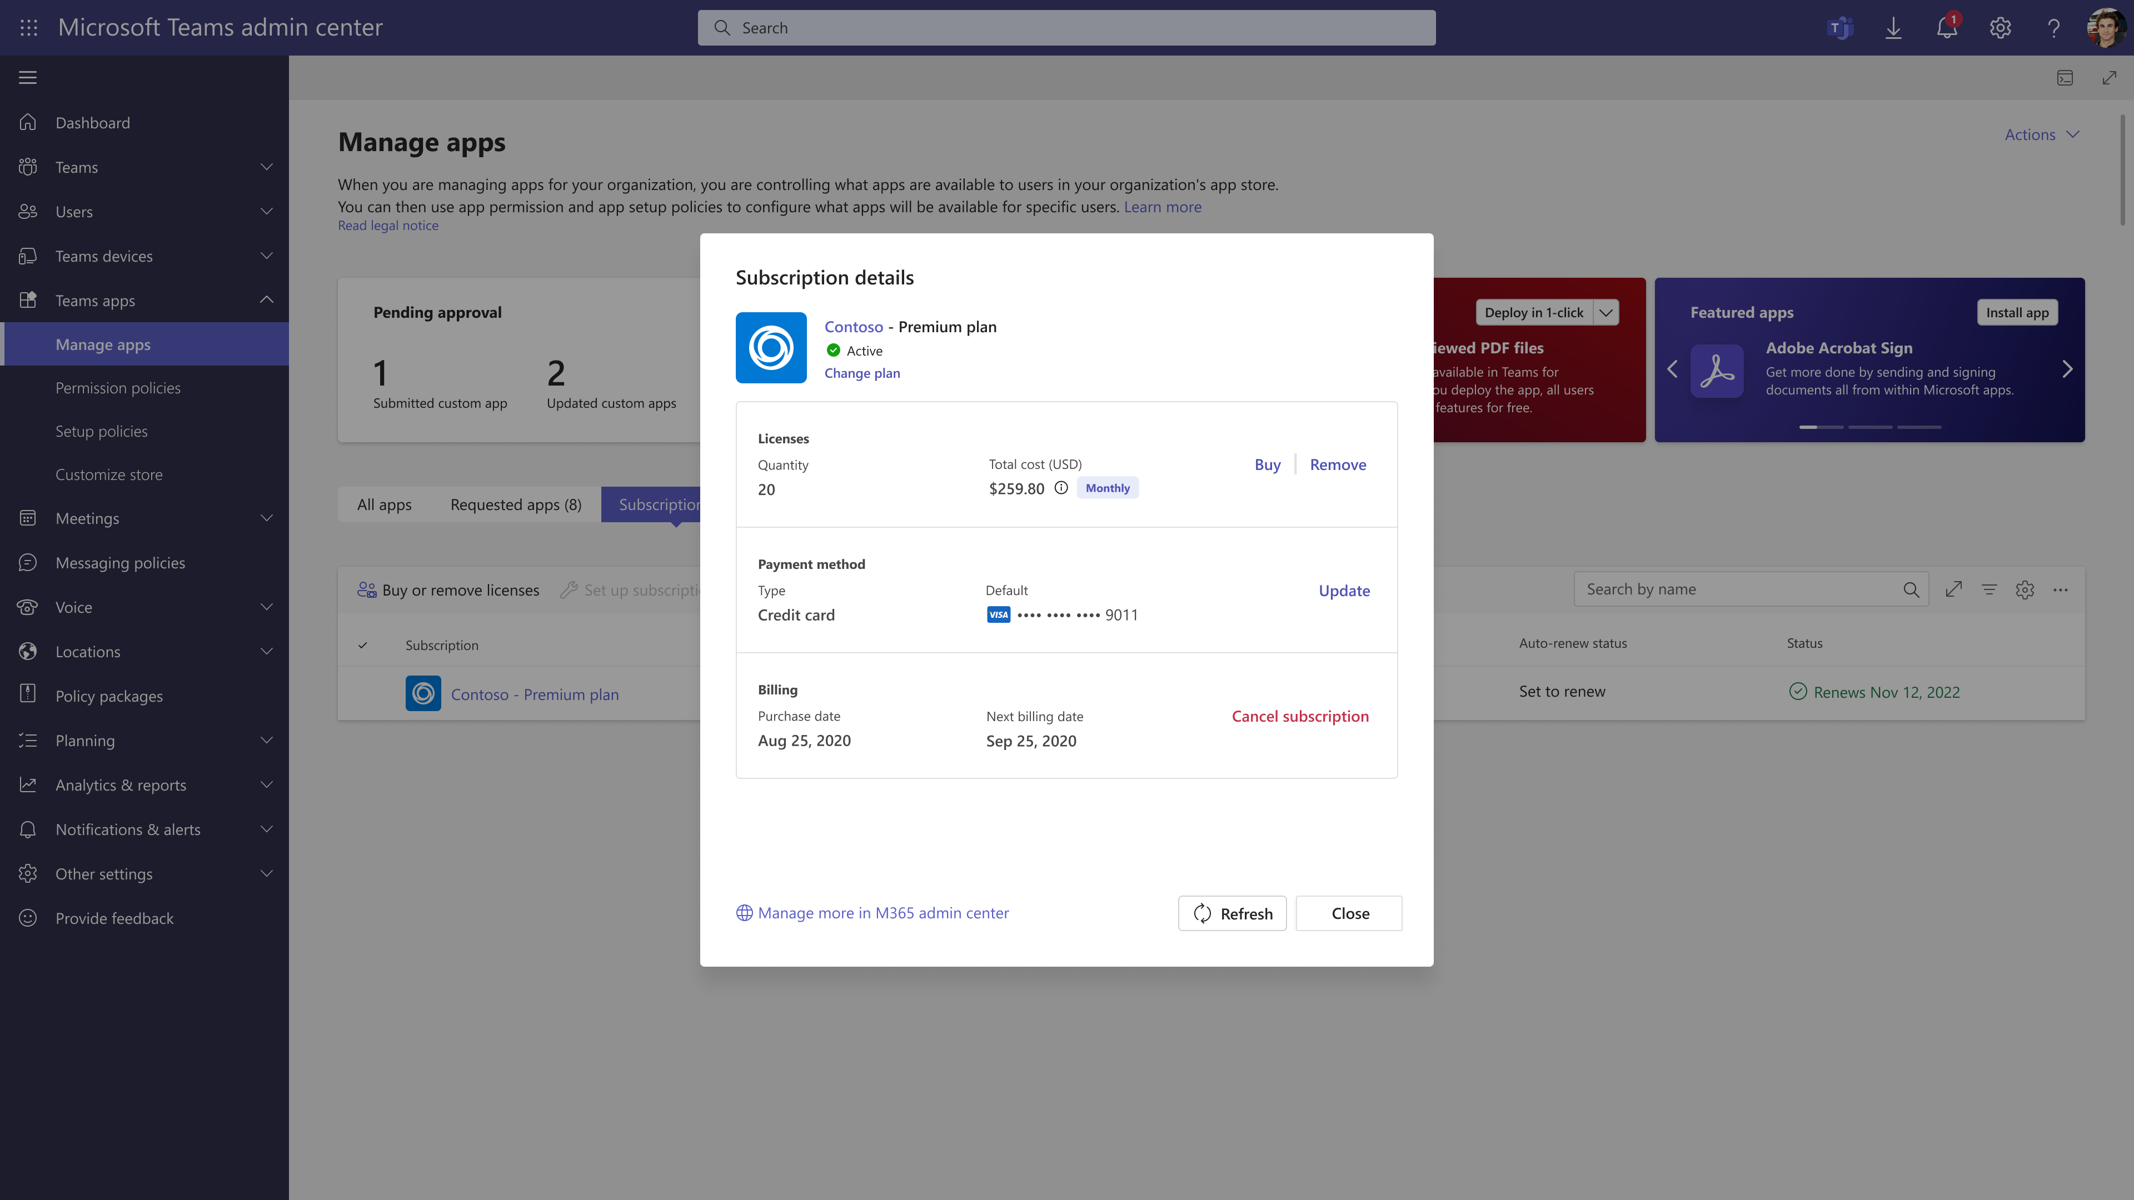
Ability to manage third-party app subscriptions from Teams Admin

Slide 56
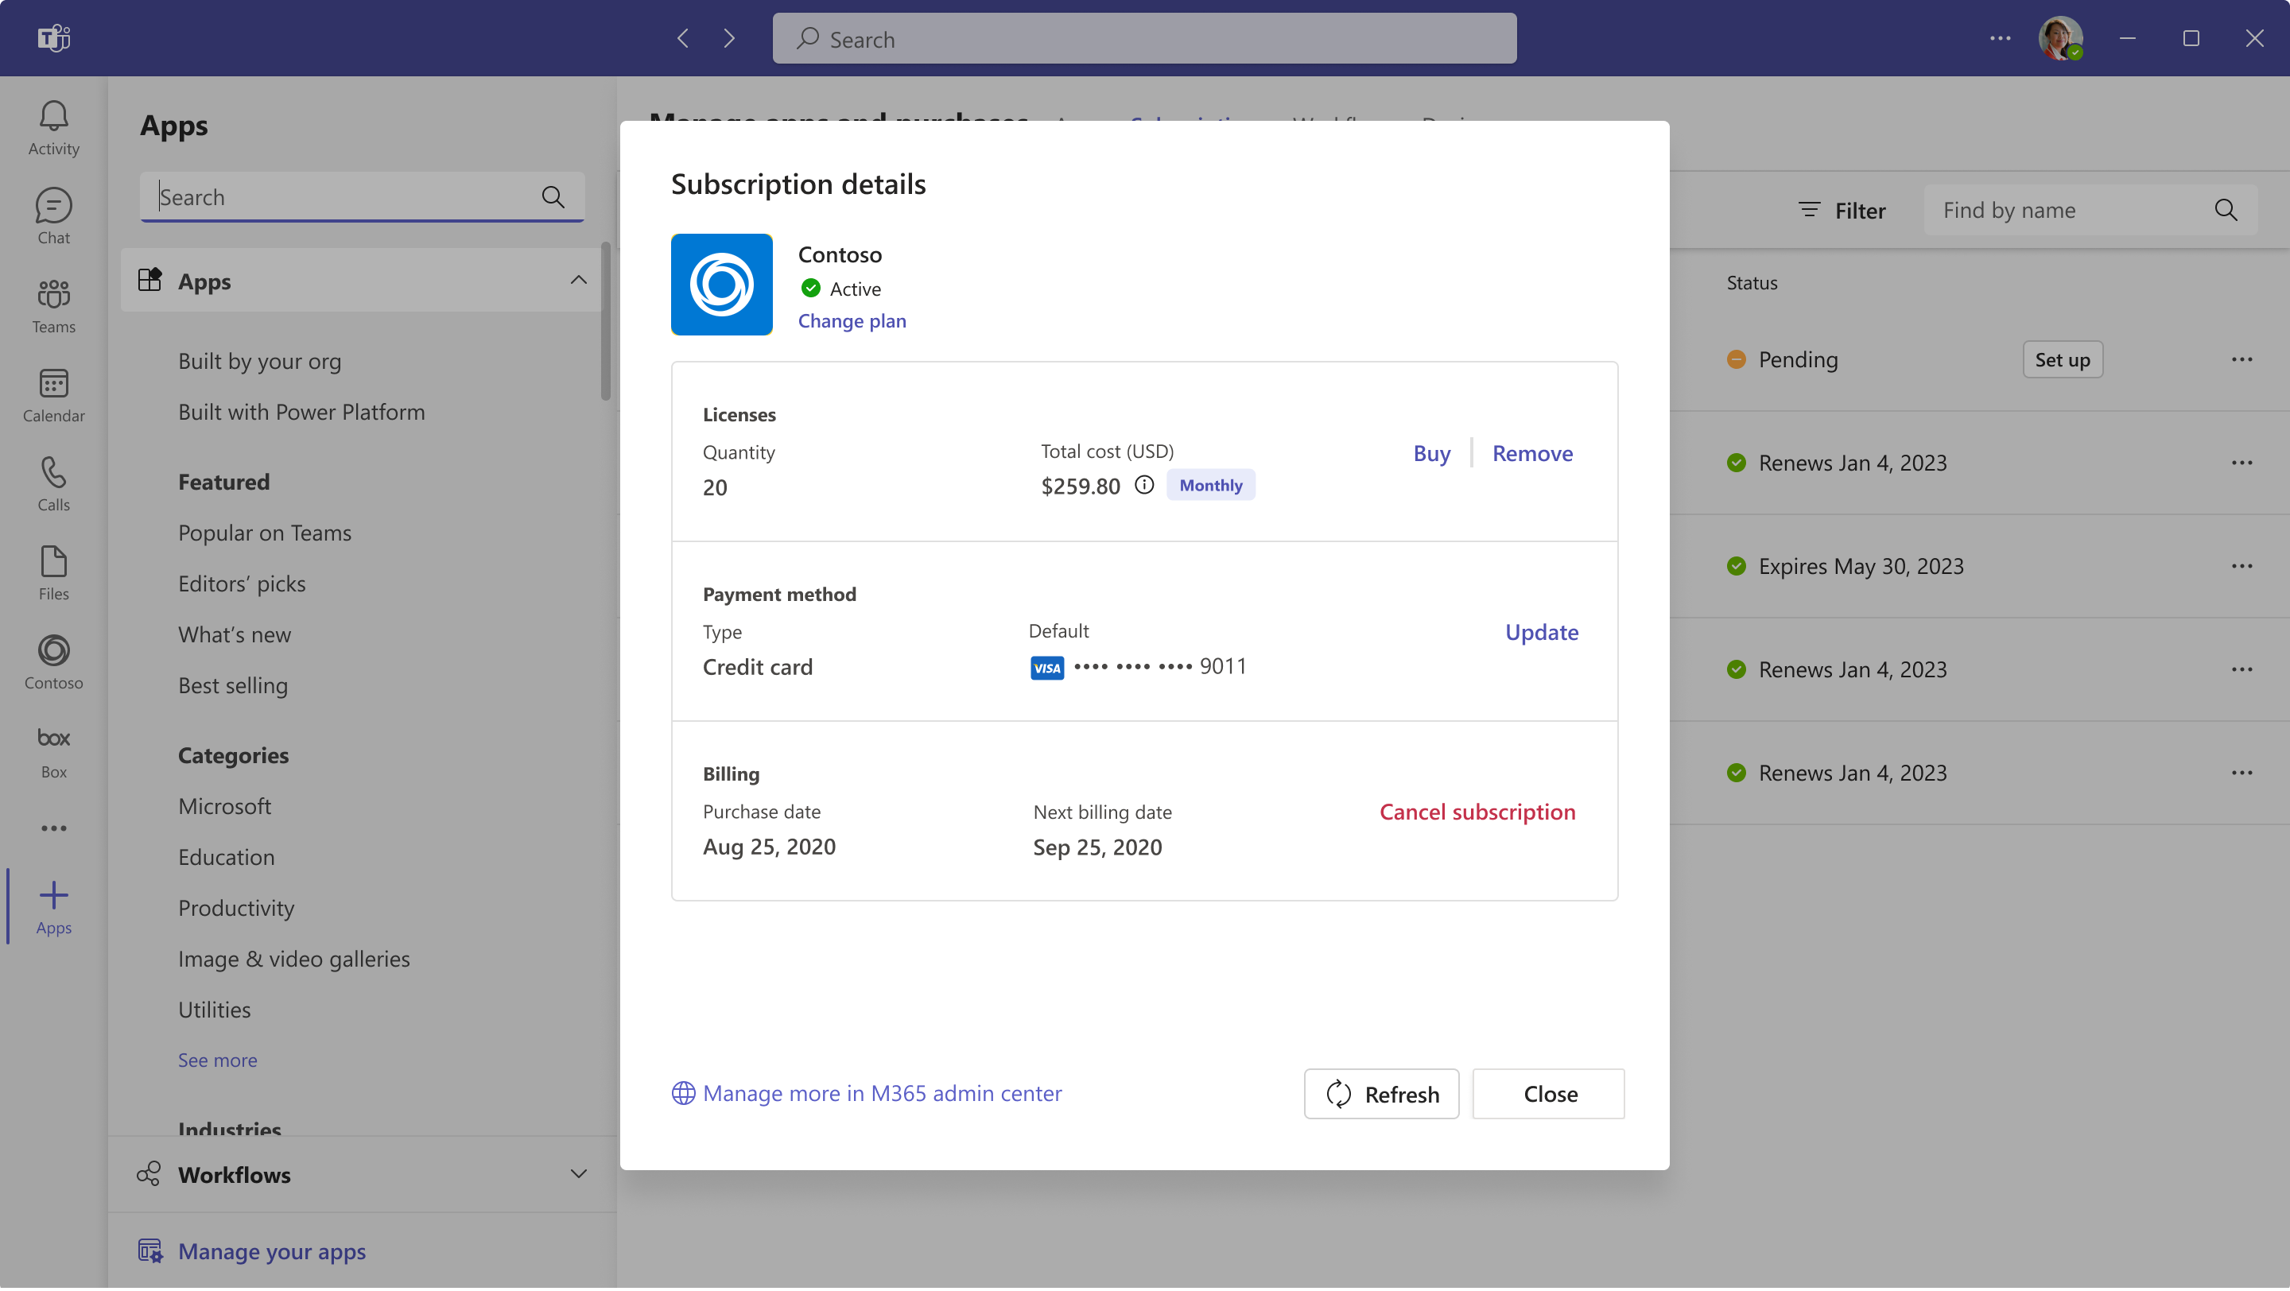
Ability to manage third-party app subscriptions from Teams Admin

Slide 57
Neuigkeiten in Microsoft Teams für Admins
Graph API for Teams Meetings Transcripts Weitere Informationen

Slide 58
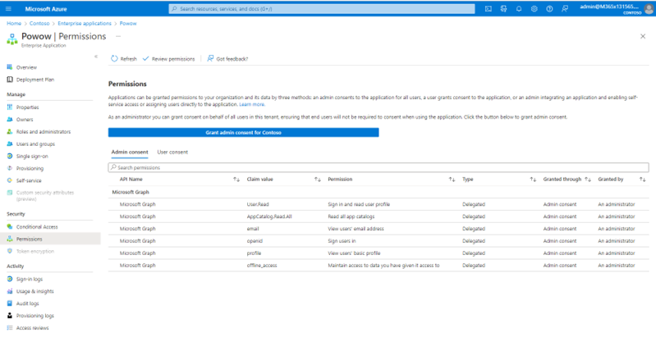
Graph API for Teams Meetings Transcripts

Slide 59
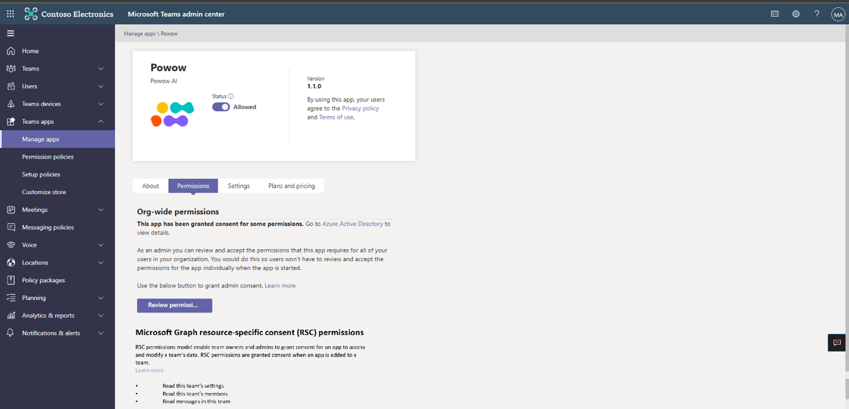
Graph API for Teams Meetings Transcripts
Notes:
Meeting specific RSC Application Permission

Slide 60
Microsoft Teams – Links
What’s New in Microsoft Teams - June 2022
What’s New in Microsoft Teams - July 2022
What’s New in Microsoft Teams for Education | June 2022
What’s New in Microsoft Teams for Education | August 2022
Microsoft Teams Blog
Microsoft Teams Community Blog
Microsoft Teams Feedback Portal

Slide 61
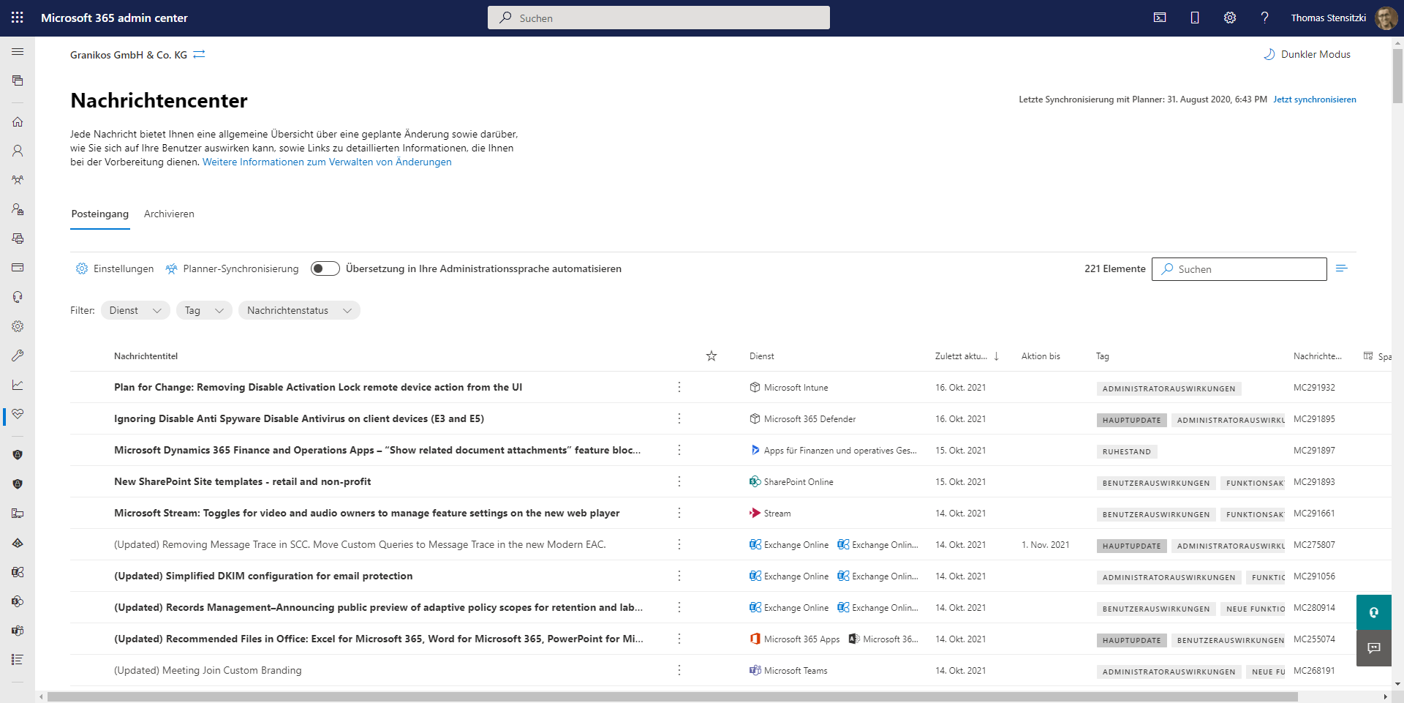
https://admin.microsoft.com/#/MessageCenter

Slide 62
Titel
Speaker @TW

Slide 63
Organisatorisches

Slide 64
Veranstaltungen
Datum
12.-14. September 2022 | European MCT Summit 2022 (7.-9.9. Approved Technical Trainer Course)
20./21. September 2022 | The Experts Conference (TEC)
23. September 2022 | Cloud8 Summit
26.-28. September 2022 | European Cloud Summit
20. Oktober 2022 | Teams User Group Berlin – Meetup #21 → Hybrid Meetup
28. November -1. Dezember 2022 | European SharePoint, Office 365 & Azure Conference
8. Dezember 2002 | Teams User Group Berlin – Meetup #22

Slide 65
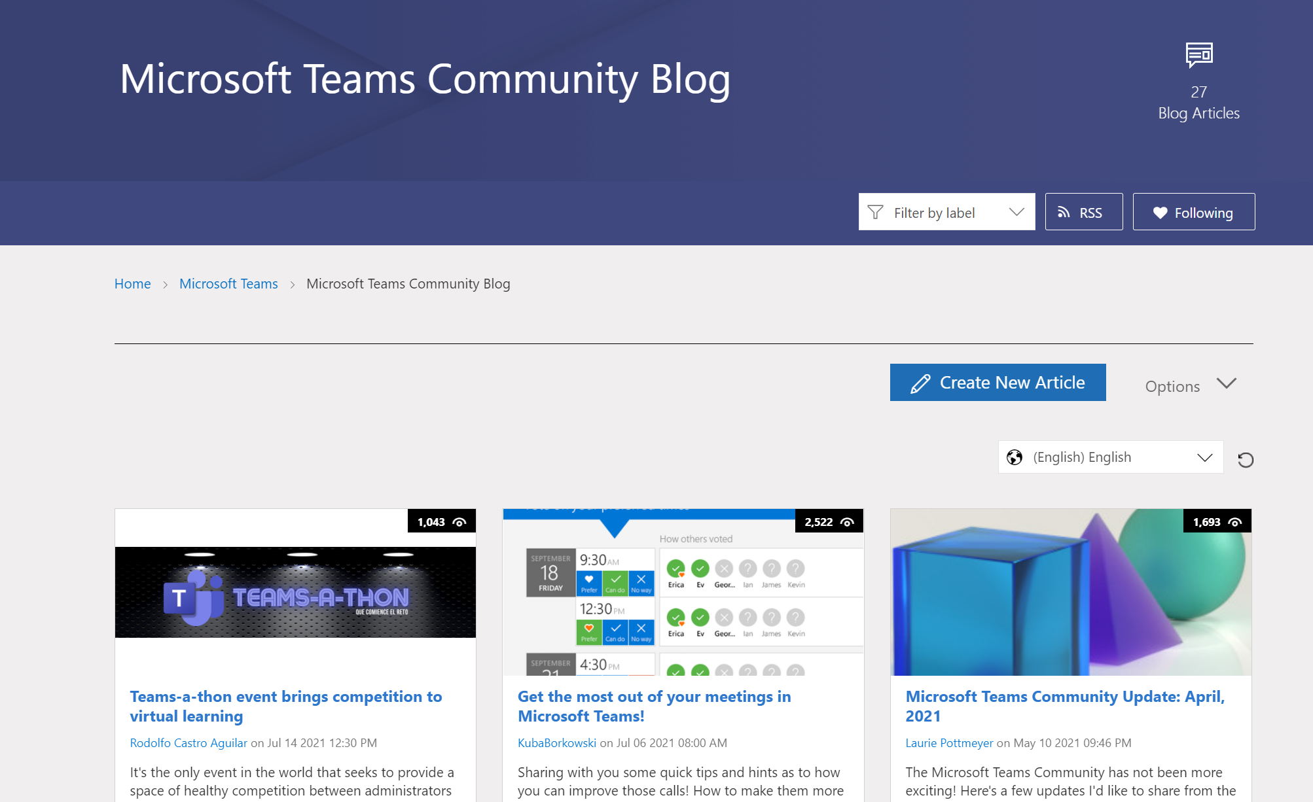
Teams Community Blog
→https://aka.ms/TeamsCommunityBlogger

Slide 66
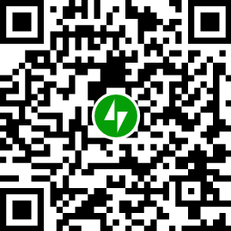
Organisatorisches
Microsoft Community Tenant für User Groups
Teilnahme als Microsoft 365 Gast
Anmeldung: https://go.granikos.eu/TeamsUGForm
Teams Meeting Teilnahme-Link
https://teamsusergroup.berlin/meetup
Teams User Group Aufzeichnungen
https://teamsusergroup.berlin/video

Slide 67

Vielen Dank für eure Teilnahme!
Das nächste Meetup:
→ 20. Oktober 2022
https://TeamsUserGroup.Berlin/register
Spread the Word!
#TeamsUGBerlin
Aufzeichnungen unserer Meetups sind im Community Team und bei YouTube verfügbar.

Slide 68
Offene Diskussion

